Slide 1


MODELO CUSTOM SHOP
FY24 DALLAS-FT WORTH RECAP
September 25th, 2023
© MOMENTUM WORLDWIDE 2023 IN CONFIDENCE. THIS DOCUMENT MAY NOT BE DISTRIBUTED OR COPIED WITHOUT PRIOR CONSENT.

Slide 2
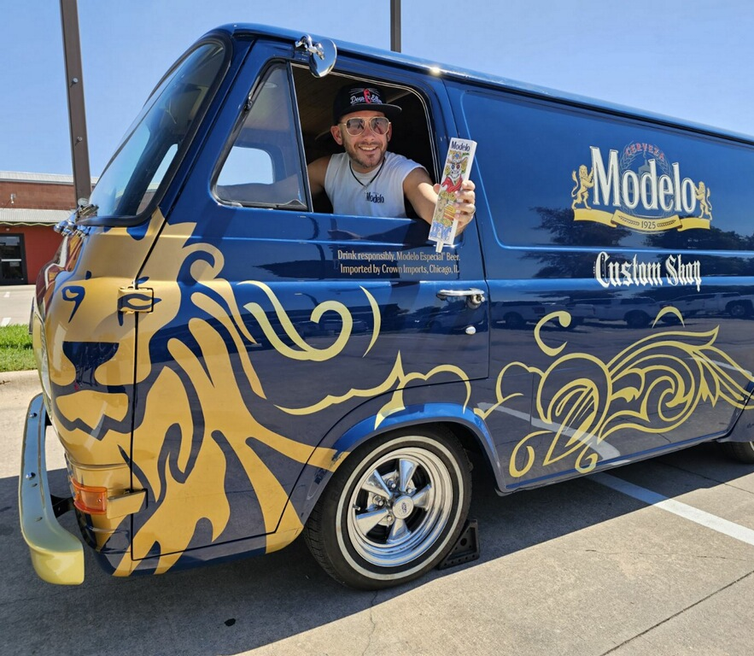
TABLE OF CONTENTS
PROGRAM OVERVIEW CONCEPT & APPROACH MARKET IMPACT RESULTS & SALES DATA PHOTOS & CONSUMERS ACCOUNT FEEDBACK KEY LEARNINGS ACCOUNT APPENDIX | 3 - 9 10 - 15 16 - 21 22 - 23 24 - 26 30 - 31

Slide 3
PROGRAM OVERVIEW
© MOMENTUM WORLDWIDE 2023 IN CONFIDENCE. THIS DOCUMENT MAY NOT BE DISTRIBUTED OR COPIED WITHOUT PRIOR CONSENT.

Slide 4
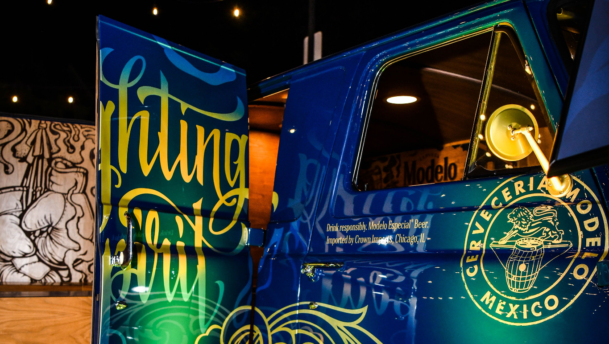
MODELO
CUSTOM SHOP
YEAR 3
Modelo Custom Shop is an elevated MBN experience with it’s core pillar being the local art community.
We drove around the country with our Modelo Custom Shop to enhance guests experiences with sampling opportunities, customizable consumer swag, and a chance to win a limited-edition Modelo scooter! An experience to inspire consumers to fight against anything ordinary.
Our shops were scaled from MBNs to an elevated experience, complete with a custom Modelo vehicle and a featured local artist.
© MOMENTUM WORLDWIDE 2023 IN CONFIDENCE. THIS DOCUMENT MAY NOT BE DISTRIBUTED OR COPIED WITHOUT PRIOR CONSENT.

Slide 5
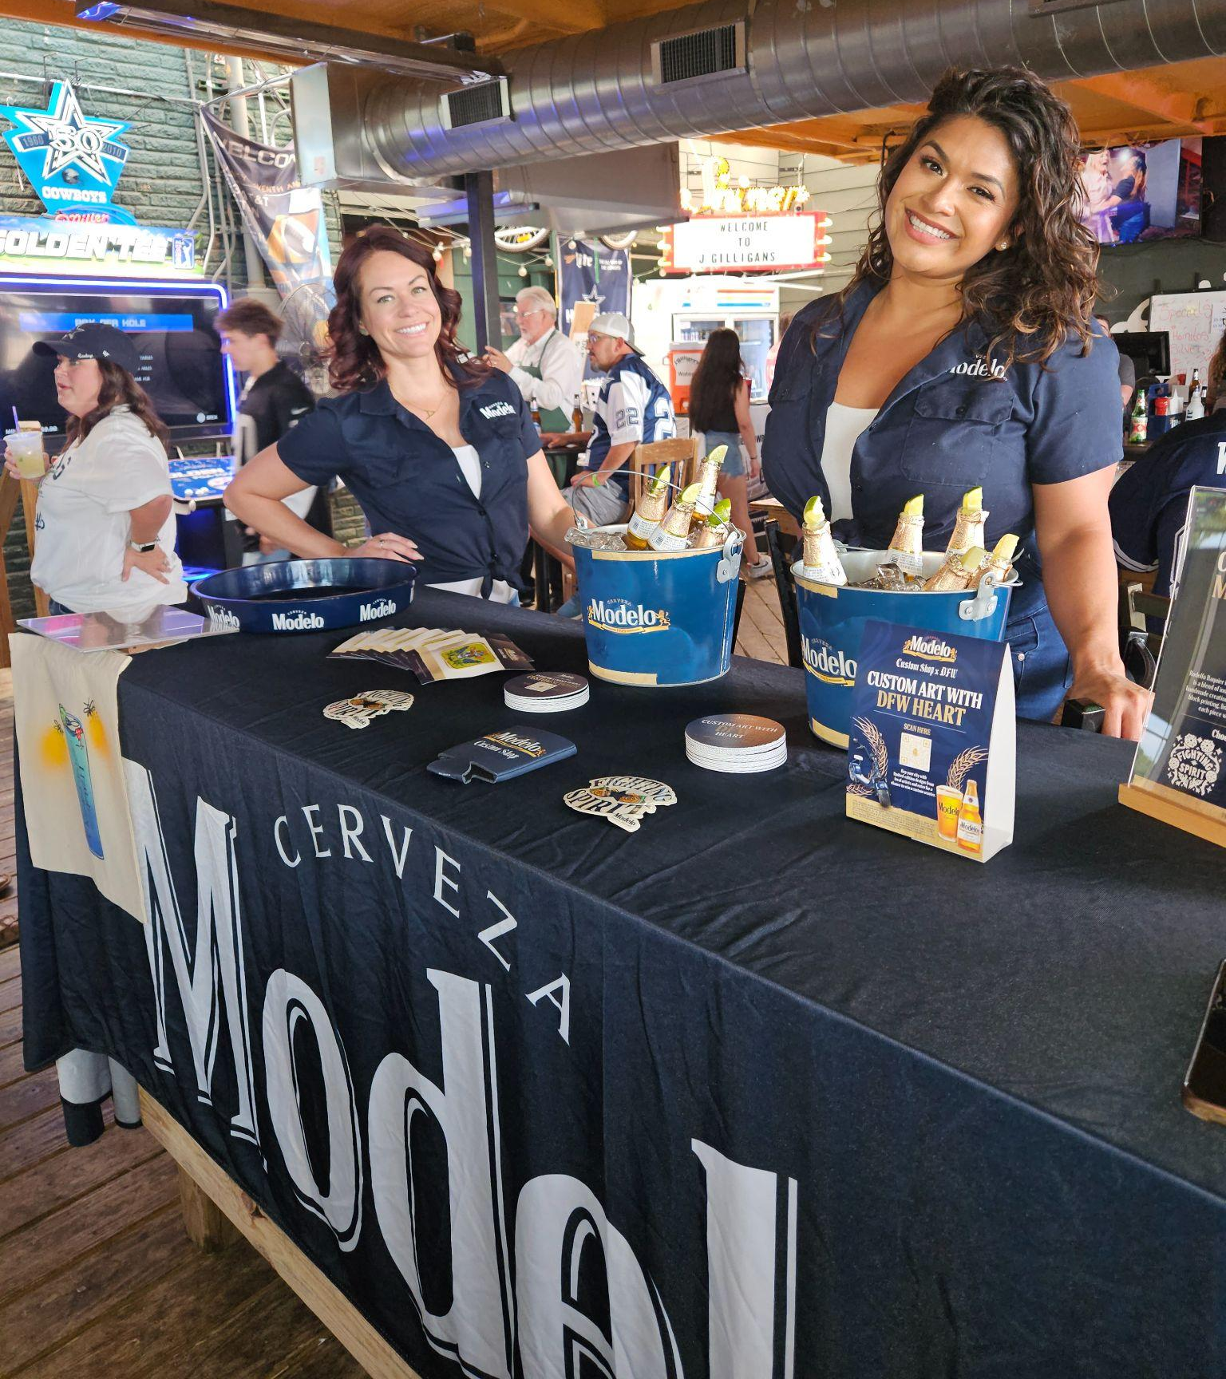
MODELO CUSTOM SHOP
MBN BASELINE
Two BAs greeted guests with an offer to sample Modelo Especial and receive customized swag with our onsite block printing. While guests waited for their custom swag, the BAs excited consumers directing them to a microsite via QR code to learn more about Modelo Custom Shop, the artists, tour stops, and to enter to win a Modelo Scooter.
Kits Include:
Modelo branded table setup and serving supplies
Modelo T-shirts, Koozies, Tote Bags
Local Artist Patches
Block Printing Supplies
3 block print designs from national artist
1 block print design from local artist

Slide 6
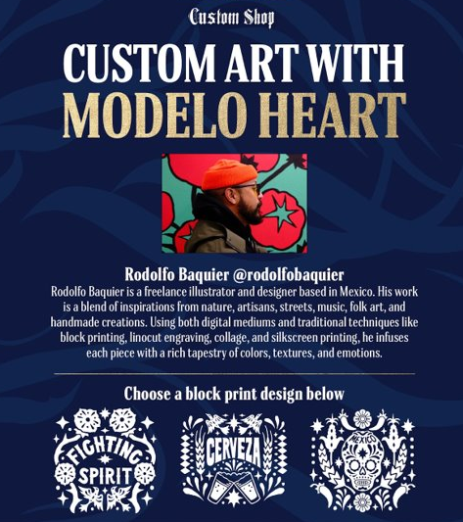
MODELO CUSTOM SHOP
BLOCK PRINT ARTIST
RODOLFO BAQUIER is a freelance illustrator and designer based in Mexico.​ He takes inspiration from nature, artisans, streets, music, folk art, food and all things handmade; His work is the amalgamation of different layers seeking for unique pieces full of character and soul.​
His range of work goes from illustration, packaging and branding to album covers, apparel and mural designs. Using digital mediums and traditional techniques like block printing, linocut engraving, collage and silkscreen printing.​
Social Reach:​
Instagram
Website​
Twitter

Slide 7
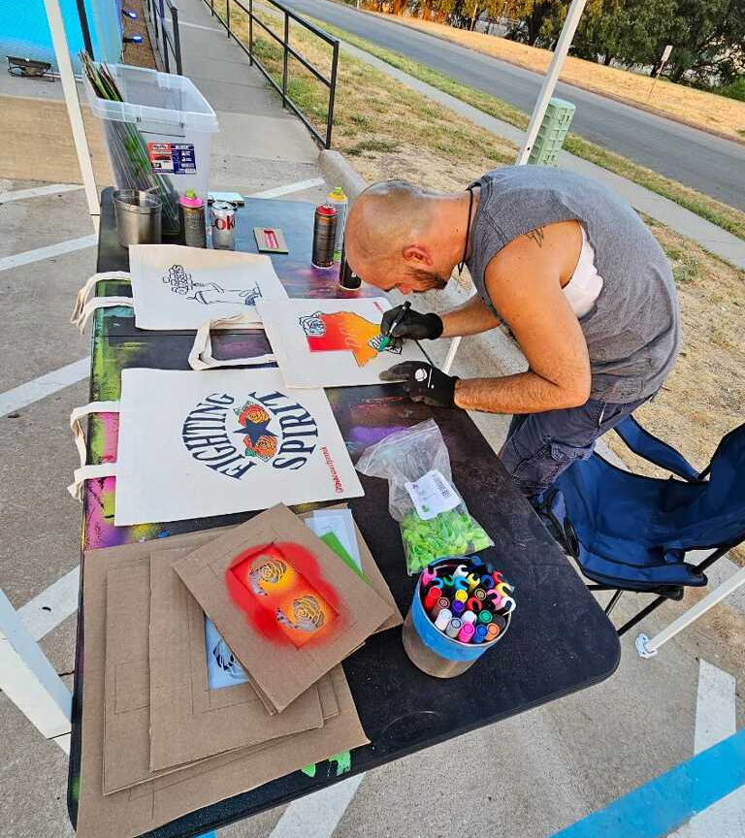
MODELO CUSTOM SHOP
MBN + VEHICLE + ARTIST
At the enhanced MBN, BAs still worked indoors to engage, educate, and excite consumers on the product and Modelo Custom Shop through sampling and block printing, while customers were also able to interact LIVE with the custom Modelo van and local artist customizing gear featuring different design techniques outdoors.
Activation included:
Staff and tool kit from MBN Program
Block printing kit and supplies
Custom Van with a Tour Manager
Local Artist appearance
Pre-promotion from artist
POS and social assets on account platform(s) will promote upcoming artist appearances to drive traffic.

Slide 8

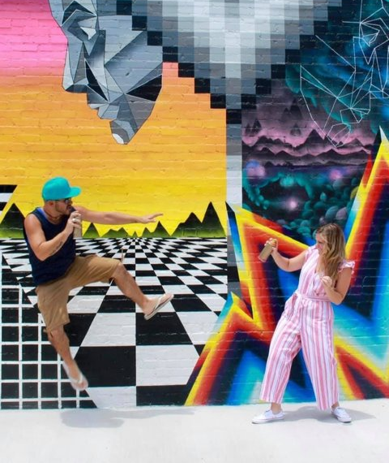
MODELO CUSTOM SHOP
LOCAL ARTIST - DFW
PRESTON PANNEK
Dallas-Fort Worth, TX
Preston Pannek, aka The House of Pannek is a Dallas art duo founded in 2017. Their work has themes of pop art and pop culture, from famous cartoons to public figures. Recent work includes collaborations with Lizard Lounge Presents and a variety of small businesses in Dallas.​
​
Social Reach:​
Instagram: 7.3K​
Website​

Slide 9


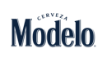
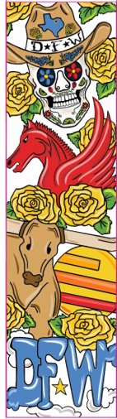
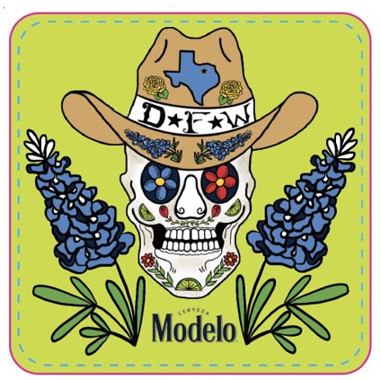
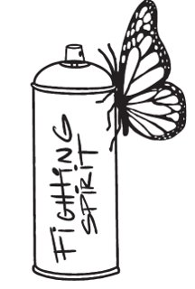
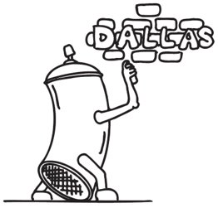

MODELO CUSTOM SHOP
PRESTON PANNEK’S ARTWORK
PATCH
TAP HANDLE
FLASH SHEET

Slide 10
MARKET IMPACT
AUGUST 10TH - SEPTEMBER 17TH
2023
© MOMENTUM WORLDWIDE 2023 IN CONFIDENCE. THIS DOCUMENT MAY NOT BE DISTRIBUTED OR COPIED WITHOUT PRIOR CONSENT.

Slide 11
MODELO CUSTOM SHOP MBN SNAPSHOT - DFW
MARKET
DFW
ACCOUNTS
23
EVENTS
34
BAR SPEND
$13,707
IMPRESSIONS
3,341
ENGAGEMENTS
3,115
SAMPLED
2,025
GIVEAWAYS
3,330
99% of sampling goal met; some accounts were slower due to extremely hot temperatures.. 10 Pre-promotion MBN’s & 24 van/artist events.
© MOMENTUM WORLDWIDE 2023 IN CONFIDENCE. THIS DOCUMENT MAY NOT BE DISTRIBUTED OR COPIED WITHOUT PRIOR CONSENT.

Slide 12
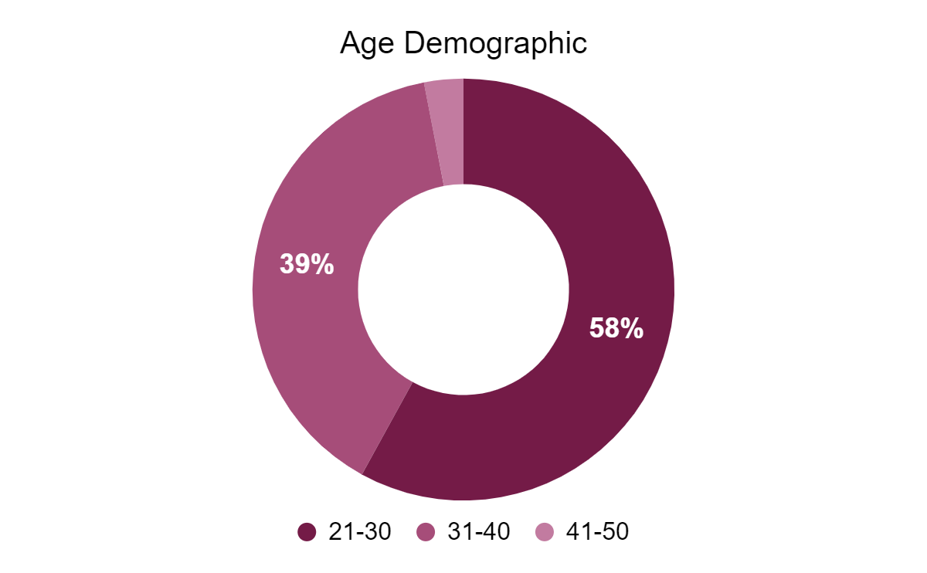
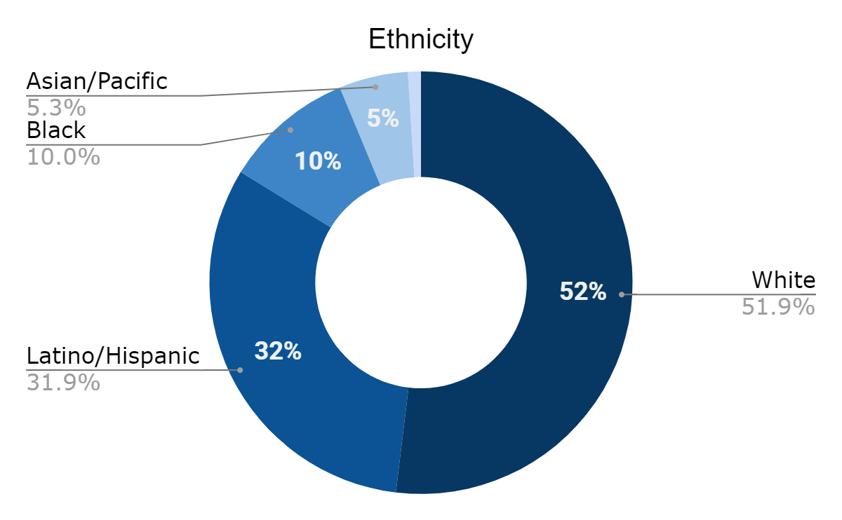
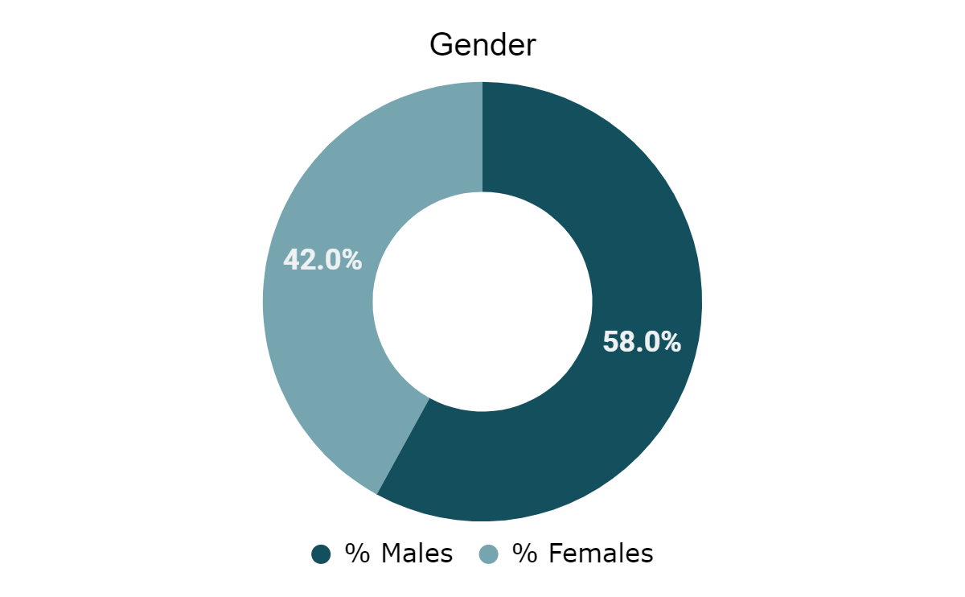
MODELO CUSTOM SHOP CONSUMER DEMOGRAPHICS
A majority of consumers were white & hispanic males in the 21-40 age range.
To adjust the chart style, right-click or control-click on the chart and select “Format Chart Area”

Slide 13
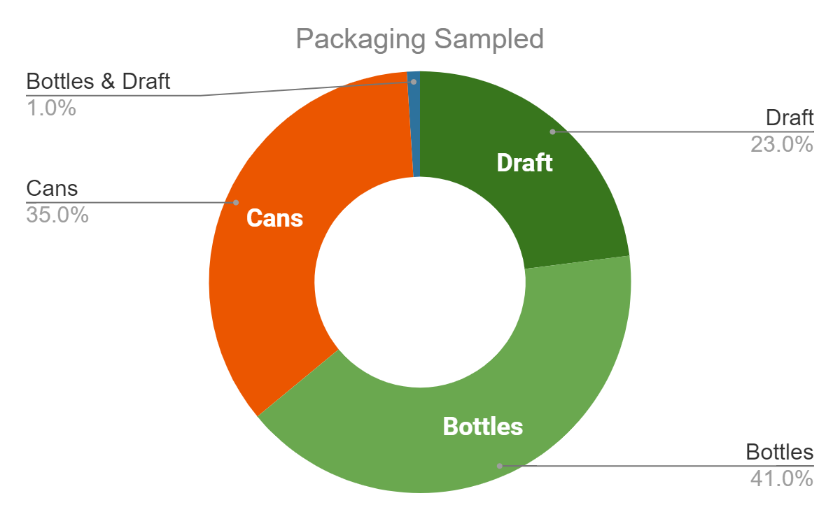
MODELO CUSTOM SHOP PACKAGING BREAKDOWN
Due to unforeseen draft issues, a majority of the accounts had either bottle or cans.
To adjust the chart style, right-click or control-click on the chart and select “Format Chart Area”

Slide 14
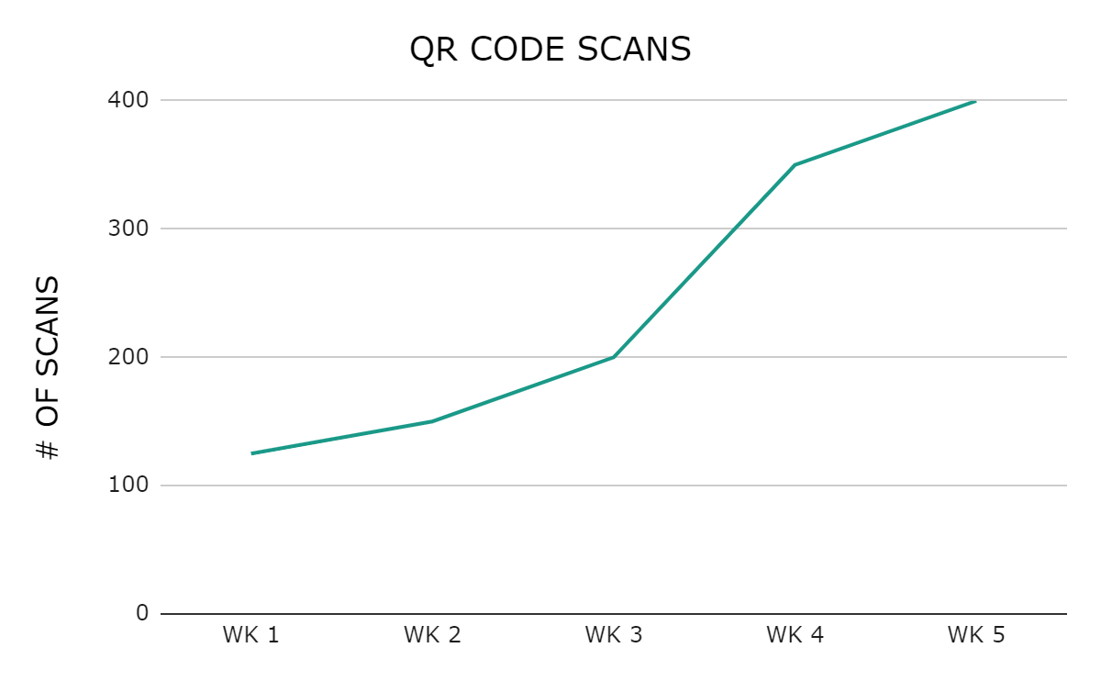
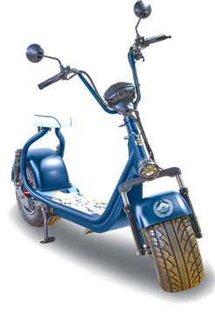
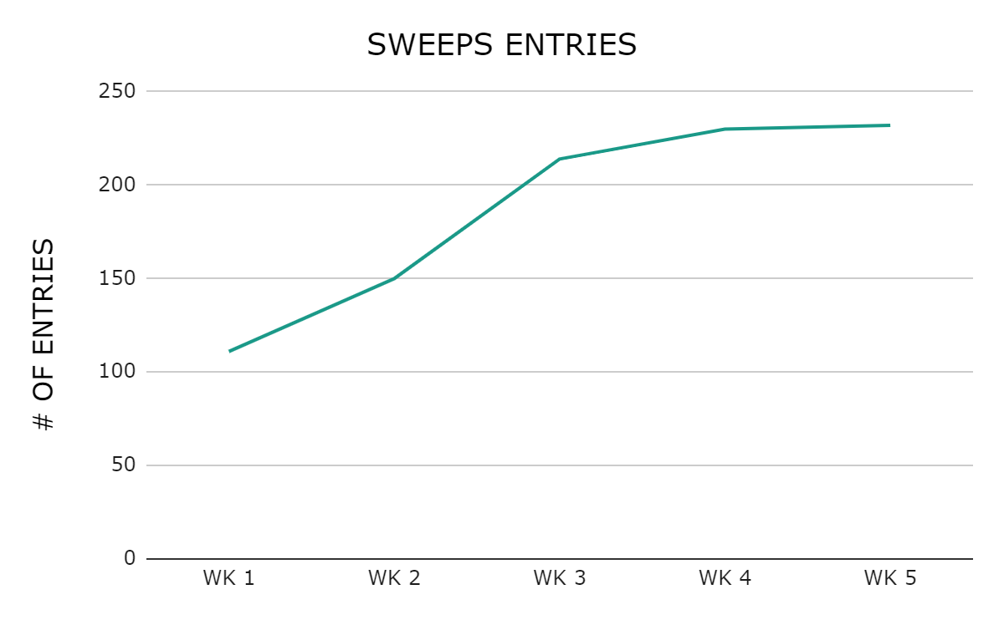
MODELO CUSTOM SHOP MICROSITE & SWEEPS ENGAGEMENT
The elevated prize of the Phat Scooter drove consumer engagement, which increased traffic and sweeps entries on the microsite.
1,511 QR Code Scans & 937 Sweeps Entries from 8/10 - 9/17
To adjust the chart style, right-click or control-click on the chart and select “Format Chart Area”

Slide 15
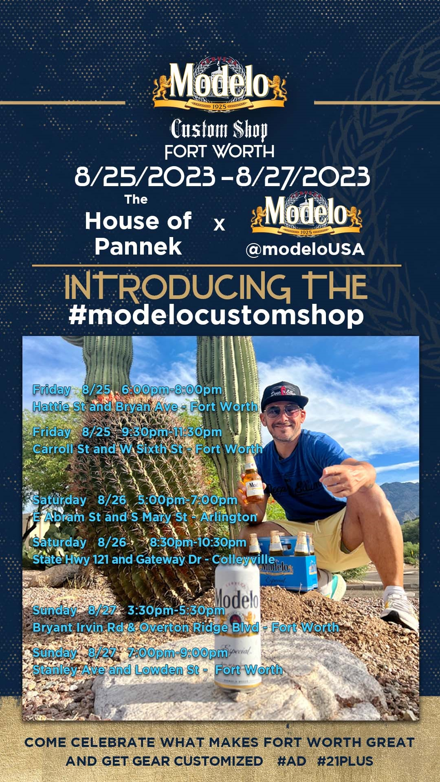
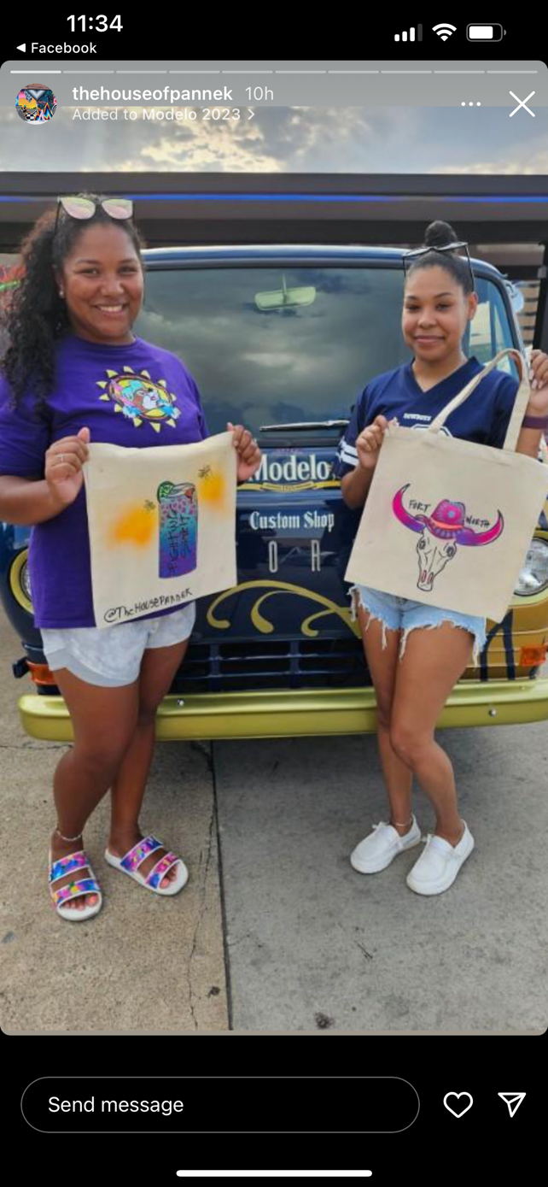
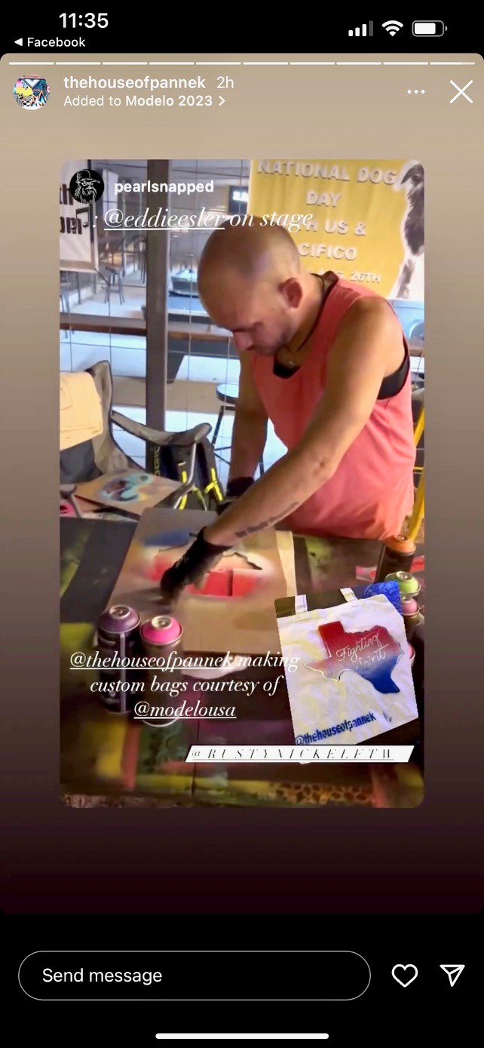
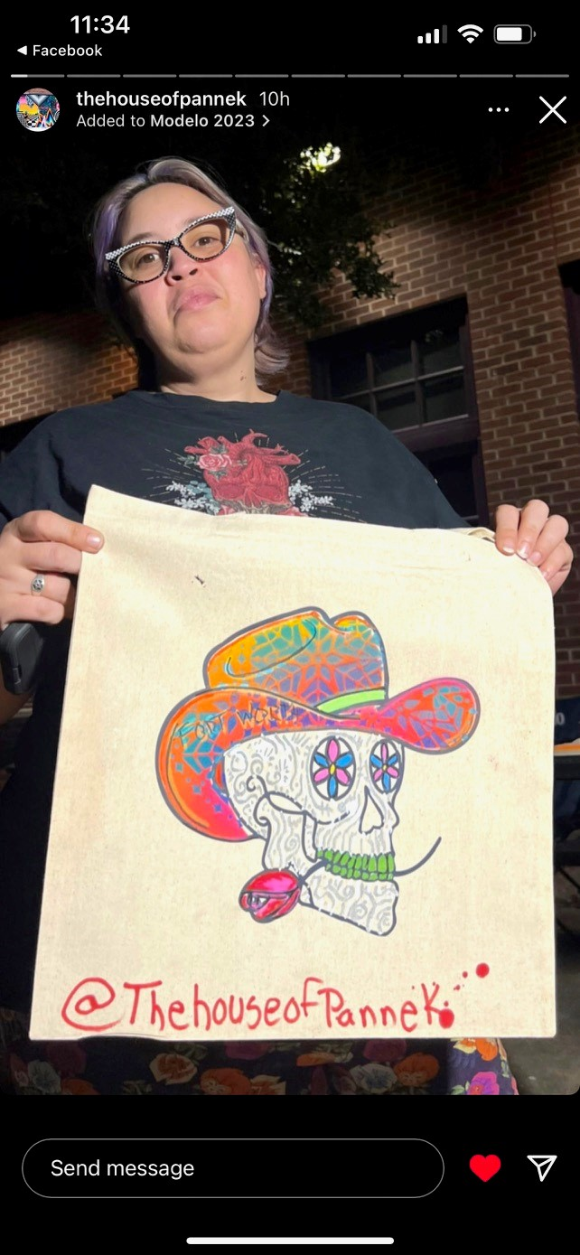
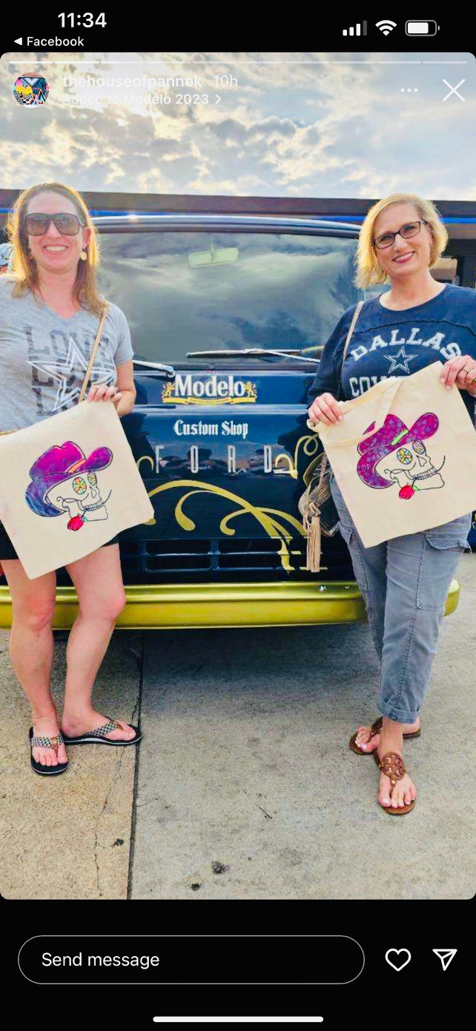
MODELO CUSTOM SHOP
SOCIAL POSTS
With over 7k followers, the local artist, Preston, made some great traction online, engaging with consumers, promoting the events, and creating more brand visibility. He posted some of his unique, custom designs, creating a buzz within the local community.

Slide 16
PHOTOS & CONSUMERS
© MOMENTUM WORLDWIDE 2023 IN CONFIDENCE. THIS DOCUMENT MAY NOT BE DISTRIBUTED OR COPIED WITHOUT PRIOR CONSENT.

Slide 17
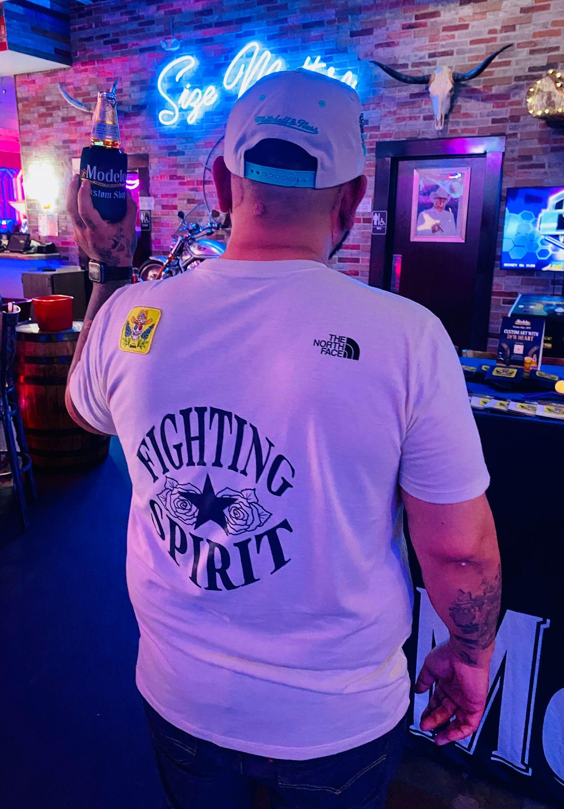
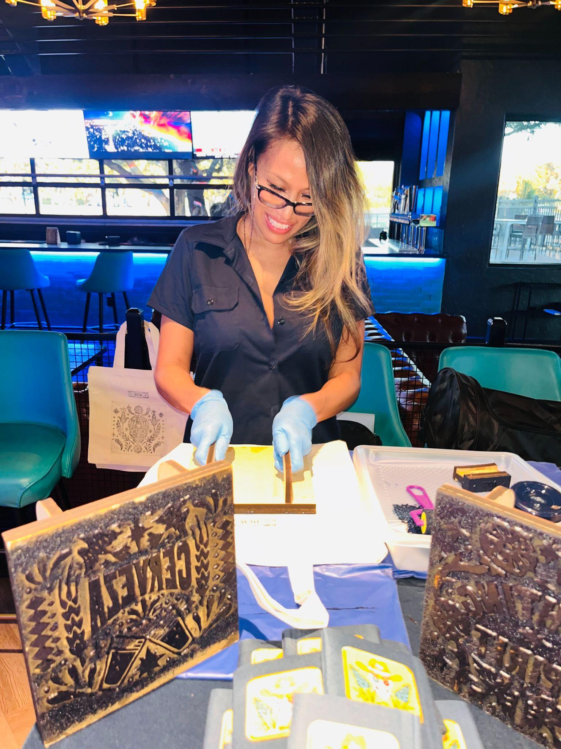
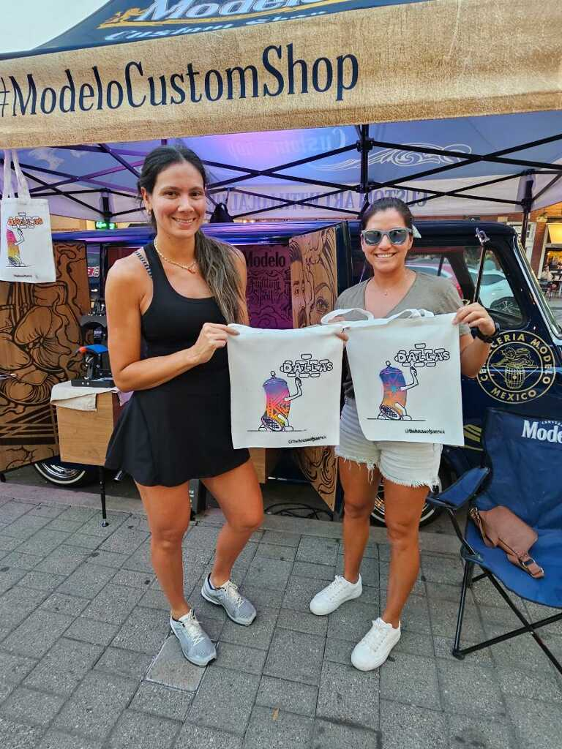
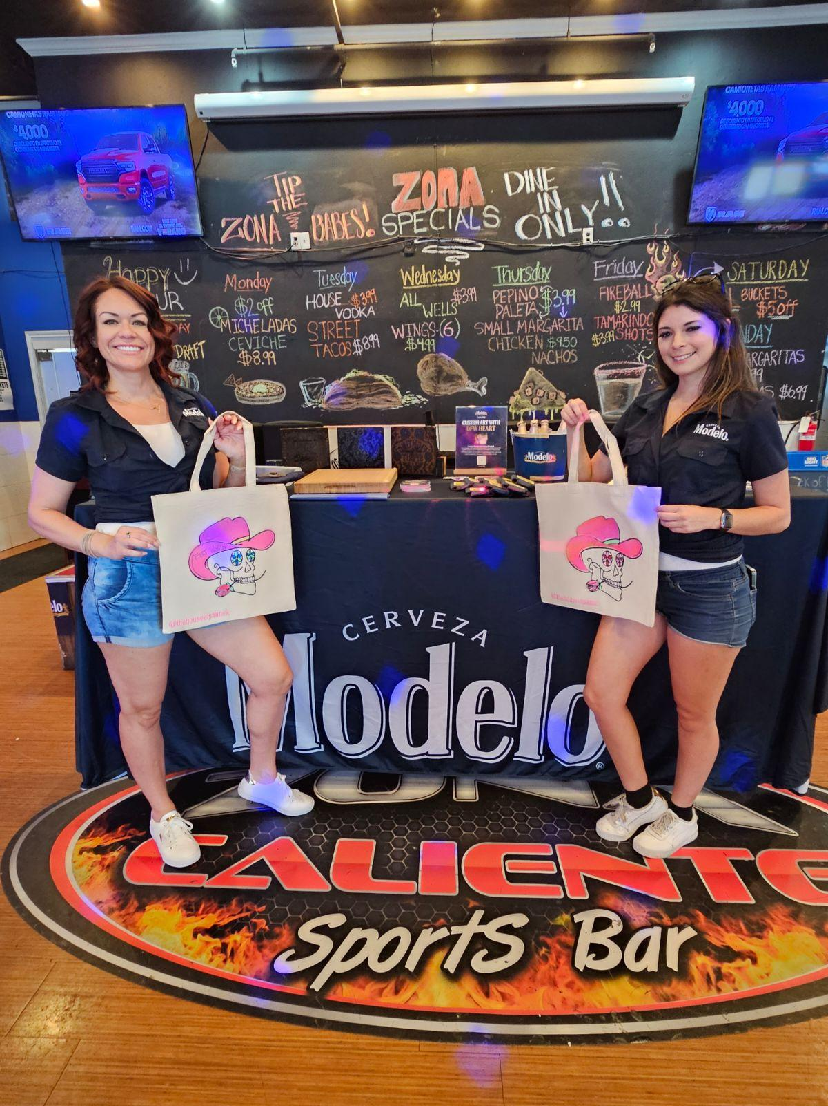
MODELO CUSTOM SHOP
MBN PHOTOS

Slide 18
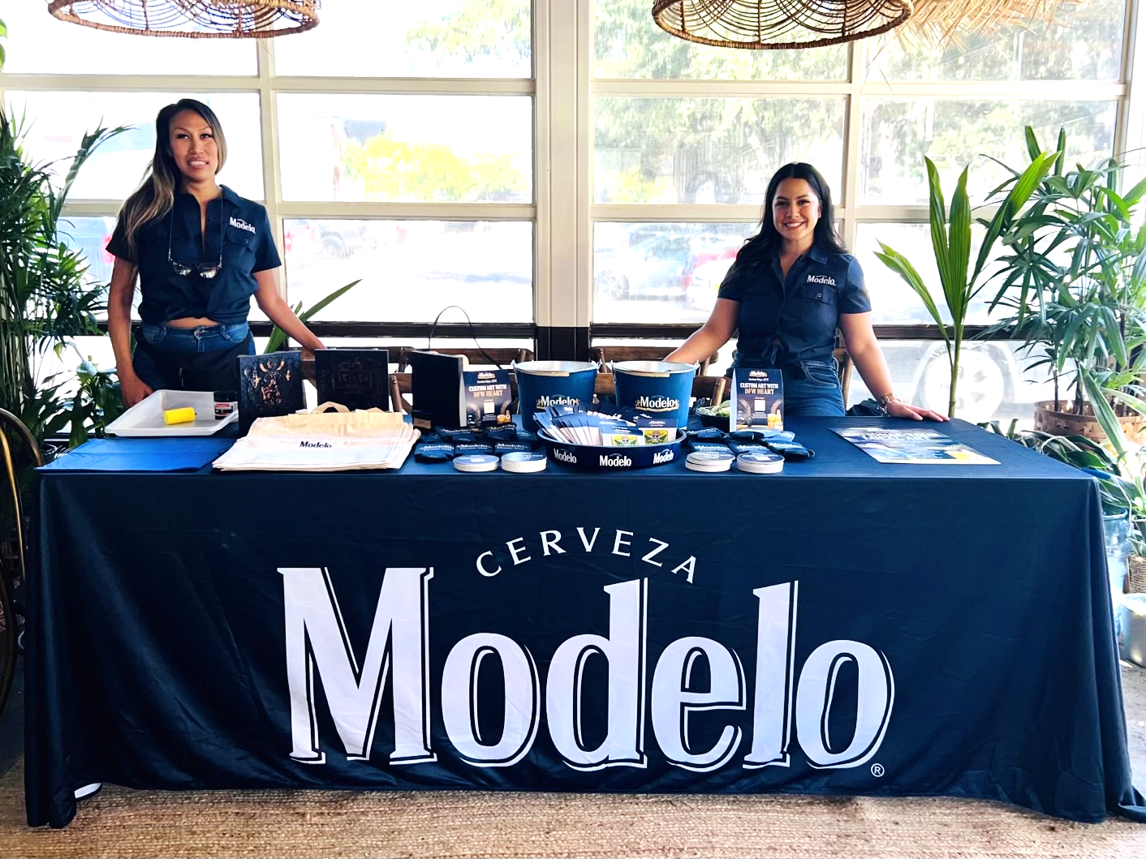
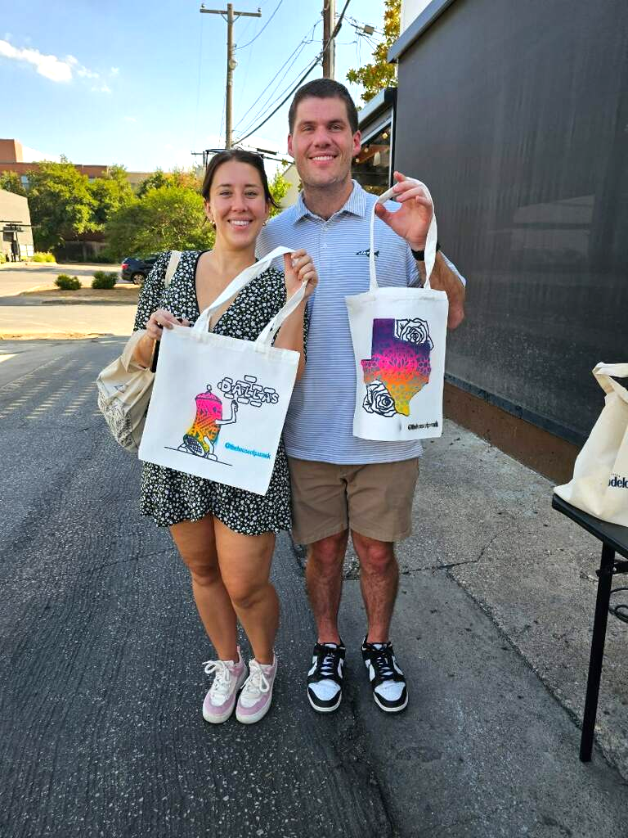
MODELO CUSTOM SHOP
MBN PHOTOS

Slide 19
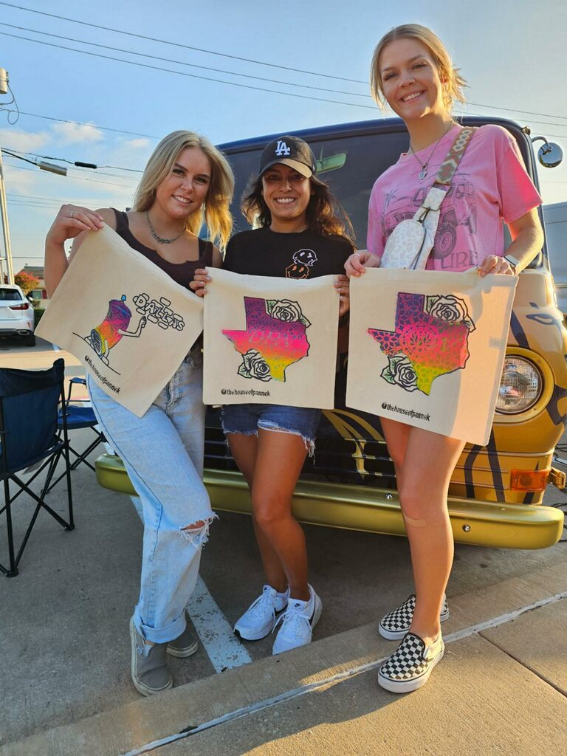
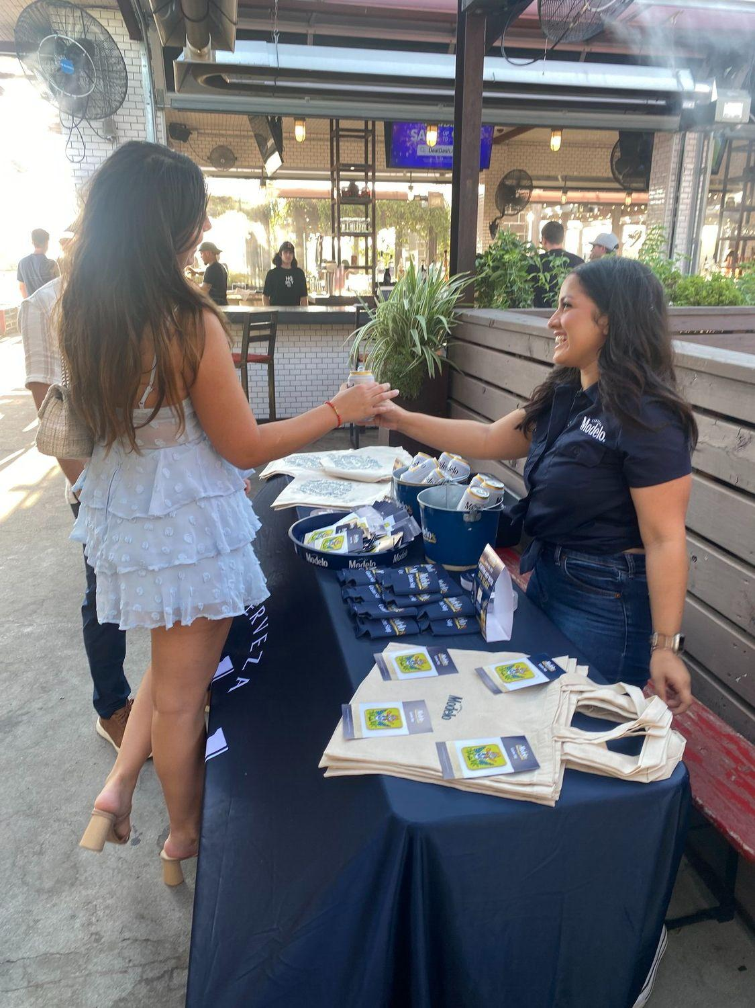
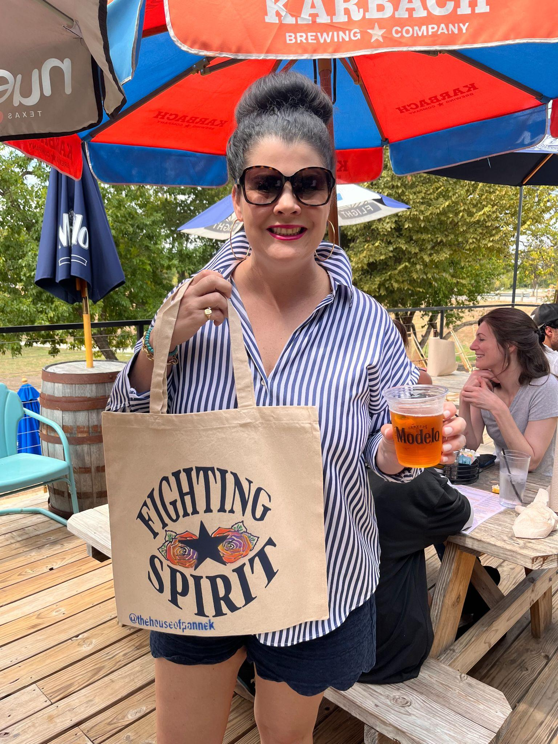
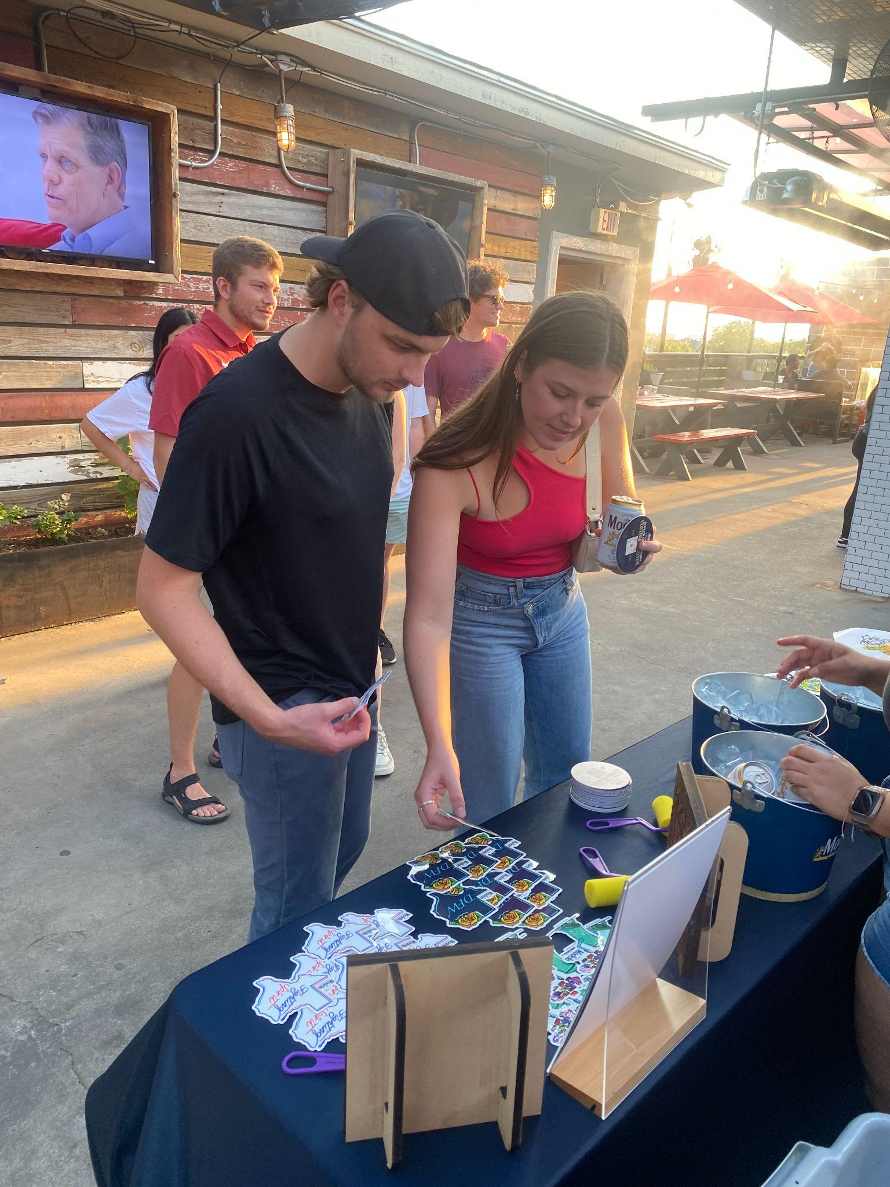
MODELO CUSTOM SHOP
MBN PHOTOS

Slide 20
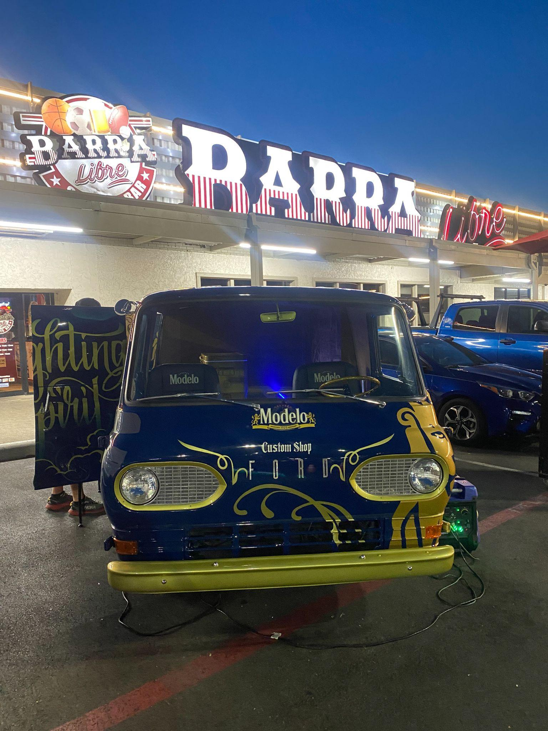
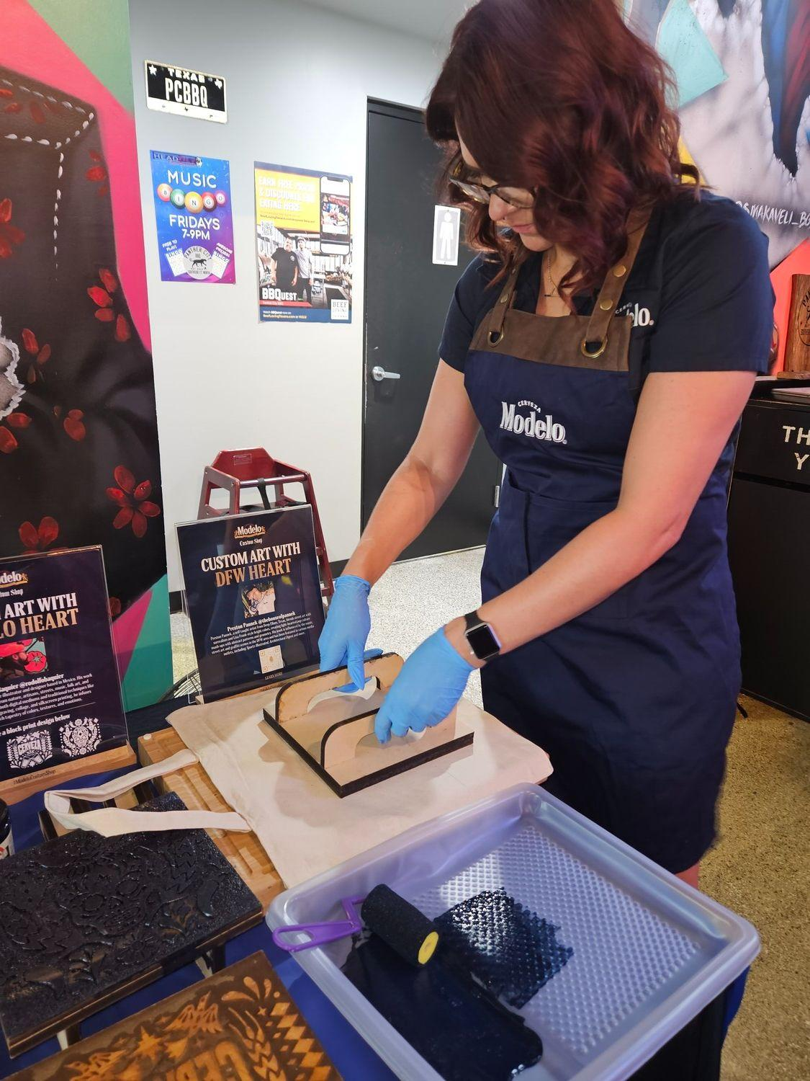
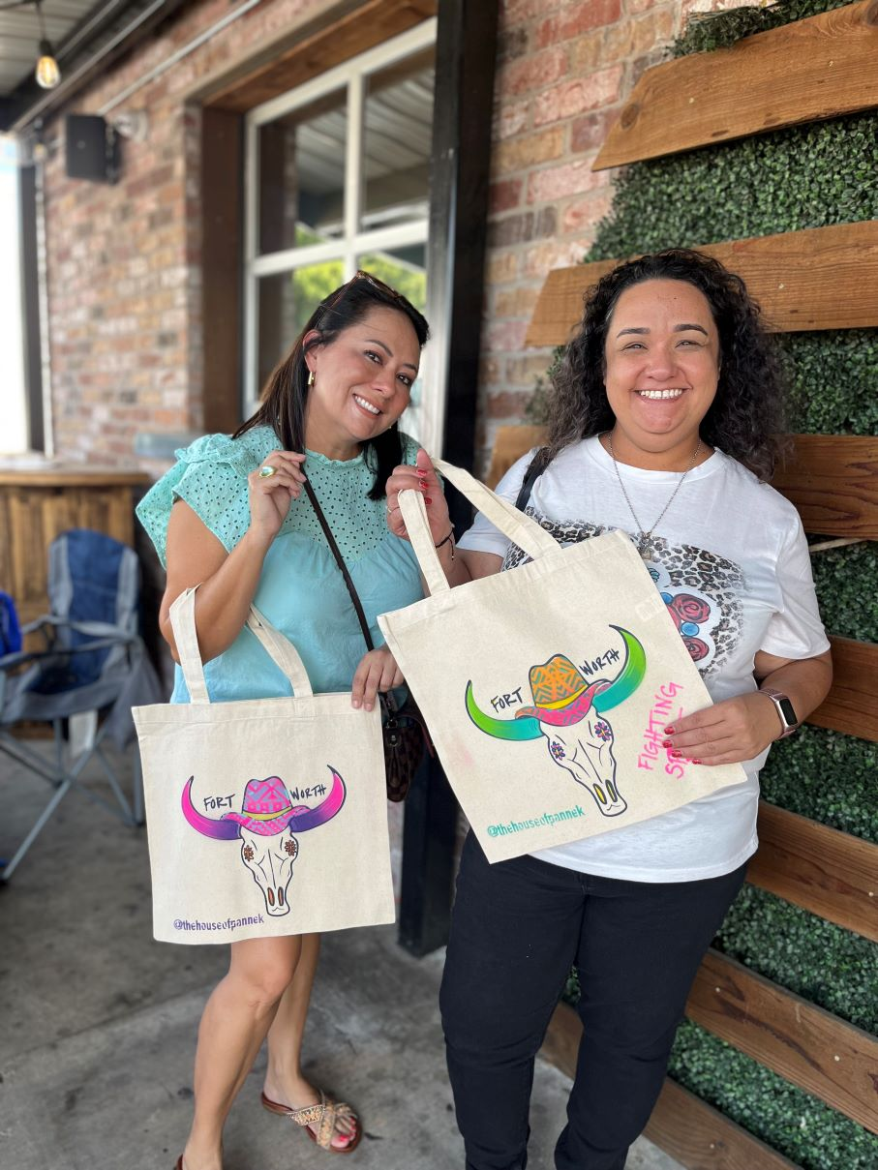
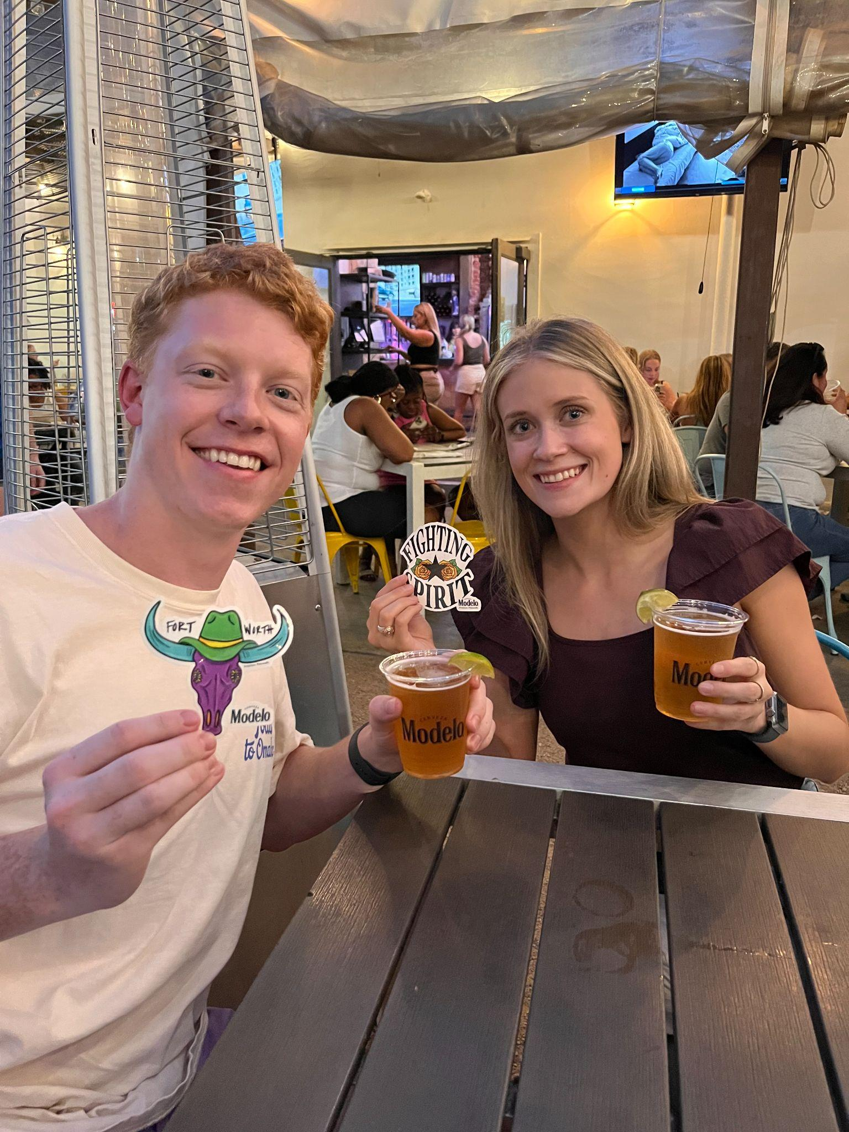
MODELO CUSTOM SHOP
MBN PHOTOS

Slide 21
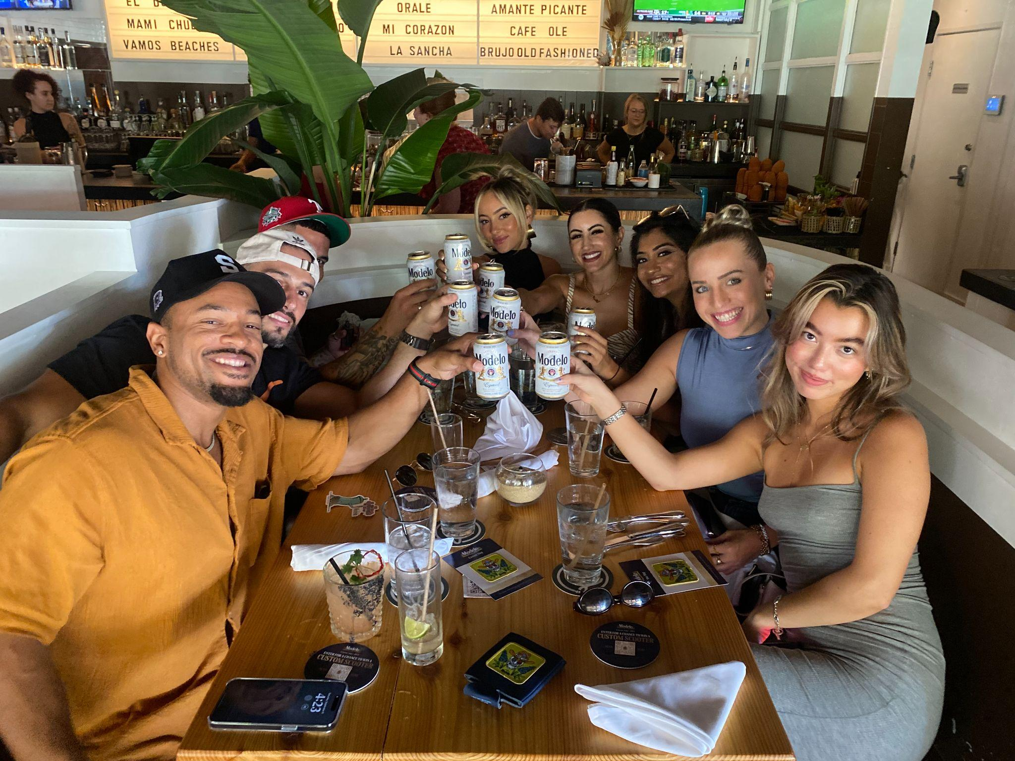
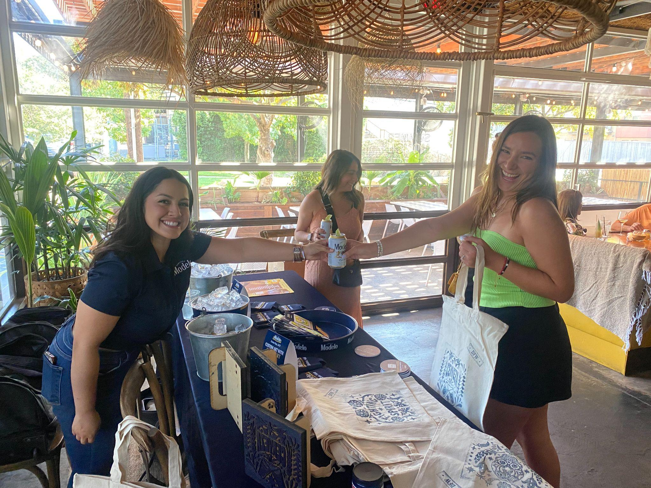
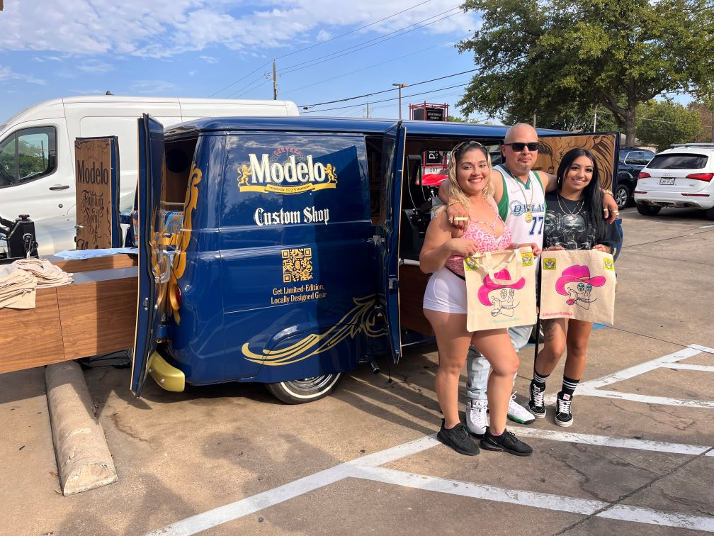
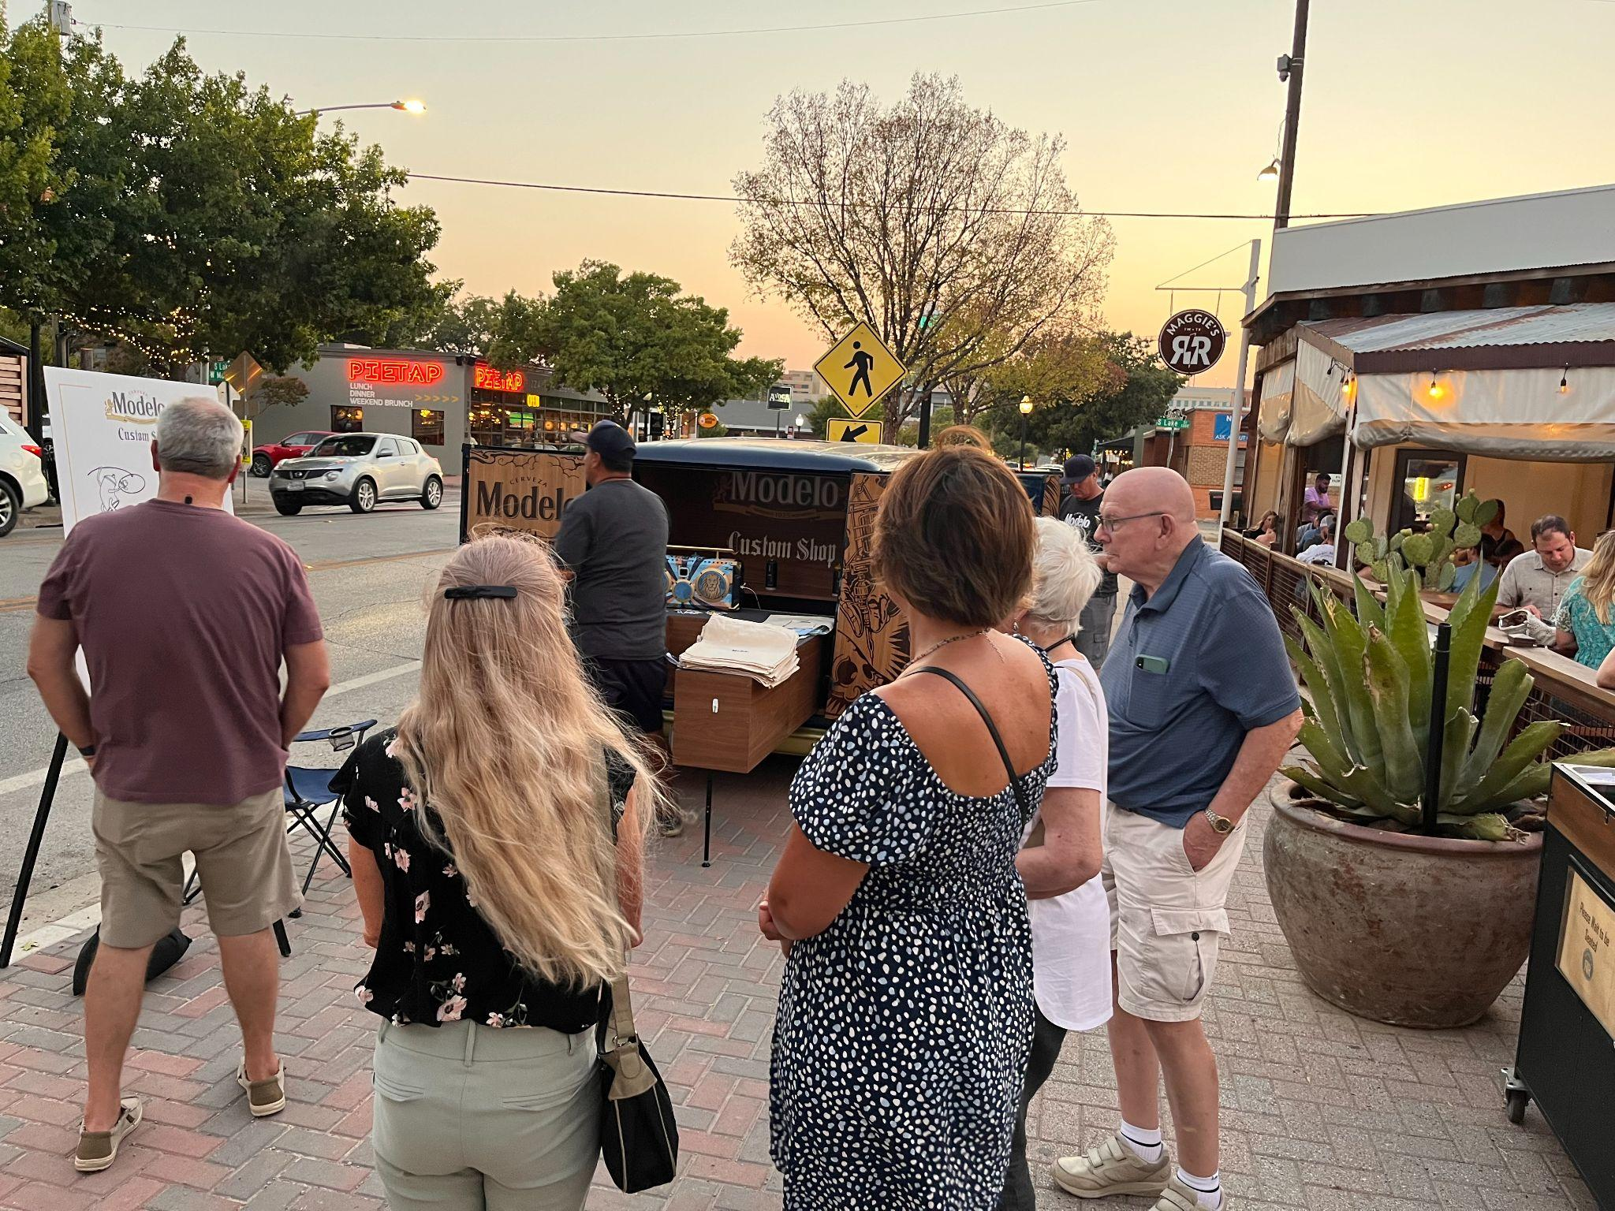
MODELO CUSTOM SHOP
MBN - CONSUMER FEEDBACK
Woody’s - “I actually have a custom tote from last year, and still use it! I would love to have another one with a new design. Modelo is the best!”
Barra Libre - “Modelo is the only beer I drink, and I will definitely be back when the van is here.”
J Gilligan’s - “I love that Modelo is supporting a local artist. And his artwork is dope!”
Federales - “I love the custom van. I never seen anything decked out like this from the inside out. Super cool.”
Yard Dawgs- “This is exactly why I love Modelo! They know how to throw an event. A great setup, and a great beer!”

Slide 22
ACCOUNT FEEDBACK
© MOMENTUM WORLDWIDE 2023 IN CONFIDENCE. THIS DOCUMENT MAY NOT BE DISTRIBUTED OR COPIED WITHOUT PRIOR CONSENT.

Slide 23
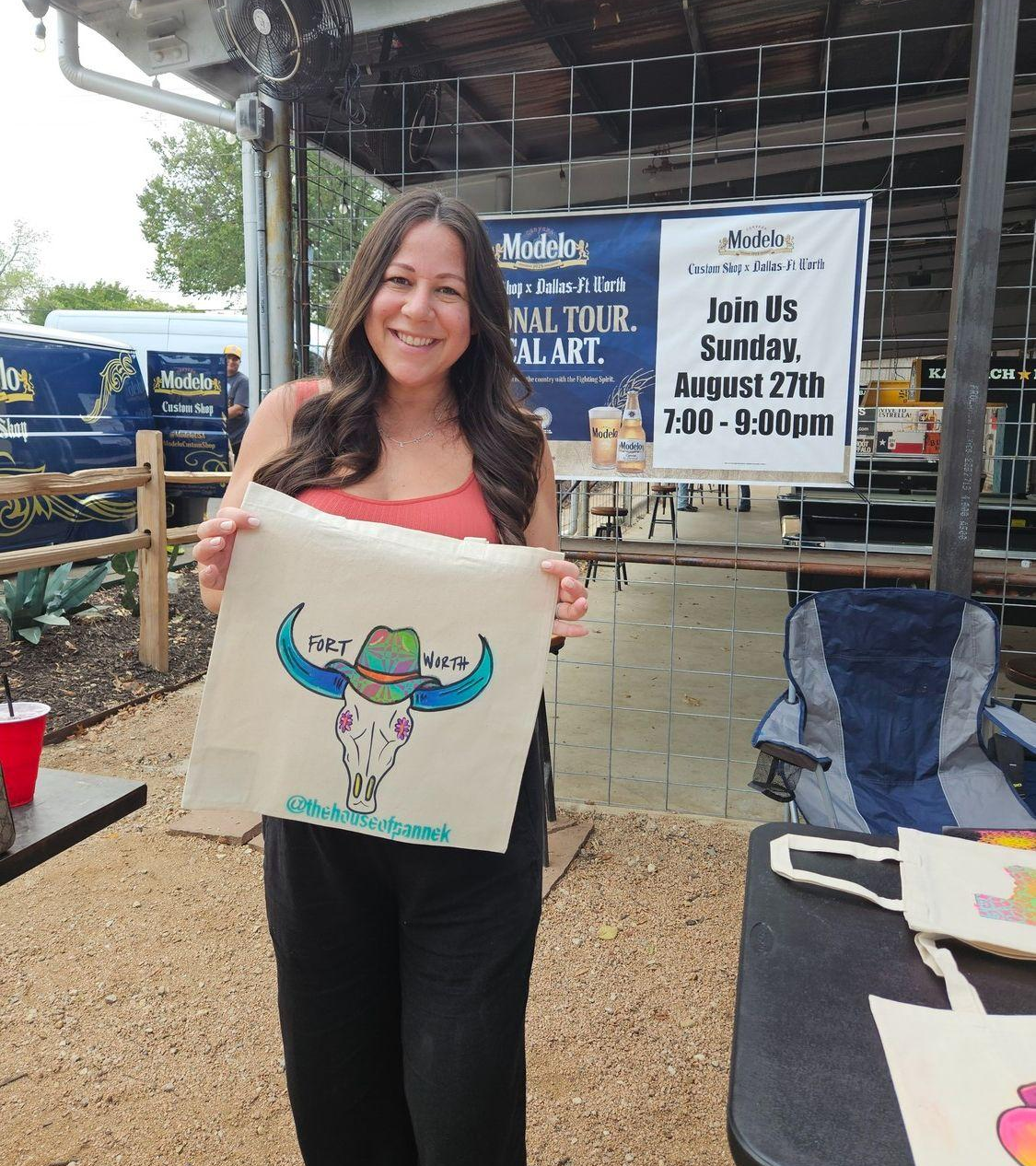
MODELO CUSTOM SHOP
ACCOUNT FEEDBACK
Trophy Chest - “I am the owner, and this event is like nothing I’ve ever seen. Modelo is my favorite beer, and would love to have ya’ll back again!”
Yard Dawgs (Murphy) - “We would love to have a custom tap handle featuring the local artist’s (Preston’s) artwork.”
Panther City BBQ -”I’d love to have a custom tote bag. Modelo is my favorite beer to drink when I get off work.”
Rabbit Hole Pub- “Modelo is very popular here. We go through a lot of product, so happy to see you all promoting here, because we have a lot of Modelo fans!”
Standard Service/Leela’s - “It’s great having you all back again this year. This program is so elaborate, and has so many great elements going on. Love the giveaways!”

Slide 24
KEY LEARNINGS
© MOMENTUM WORLDWIDE 2023 IN CONFIDENCE. THIS DOCUMENT MAY NOT BE DISTRIBUTED OR COPIED WITHOUT PRIOR CONSENT.

Slide 25
MODELO CUSTOM SHOP
MBN KEY LEARNINGS
BLOCK PRINTING TAKES A BACK SEAT AT VAN EVENTS Van events should focus on artist customizations.. Block printing is best used to alleviate long lines for the artist, or for consumers who do not plan to go outside. | SBU HAS WEATHER CHALLENGES Some of the accounts that had a larger outdoor area did not have good crowd due to the high temperatures. Finding a time during the year to activate when weather is cooler would be ideal. | ADDITIONAL GIVEAWAYS OVER PATCHES Patches were not requested by consumers as much as other items. Consumers requested key chains or other branded giveaways instead.
PROGRAMMING THAT DOES NOT OVERLAP IS IDEAL Spacing out programs strategically throughout the year works best, so local teams can focus on one program at a time. It also helps with staff retention, and creates more loyalty to the brand. | LARGER SCALE ACTIVATIONS REQUIRE MORE STAFF Doing customizations for a large crowd can be challenging when so many consumers are present. Knowing ahead of time, and having a larger team in place to prepare for the large turnout will work best for these types of events. | EMBELLISHMENT TIME MATTERS With Preston returning this year, he has refined his embellishment technique, and is able to customize giveaways quicker, reaching more consumers.

Slide 26
MODELO CUSTOM SHOP
MBN KEY LEARNINGS
ELEVATED GIVEAWAYS HIT THE MARK Custom stickers created by the local artist were a huge hit this year, and the local artwork helped create an authentic connection with consumers. | CUSTOM TAP HANDLES REQUESTED Although draft issues were going on, the accounts that did have draft were enthusiastic about receiving a tap handle, especially after meeting the local artist in person. | DISTRIBUTOR EVENTS HELP DRIVE ENTHUSIASM The local teams hosting an event to showcase the Modelo van, giveaways, and customizable pieces helped create excitement around the program.
TIMING MATTERS Outdoor/patio accounts do best when booked later in the evening due to the heat. Focusing on accounts that have a good crowd later at night helped make these activations successful. | DFW TERRITORY HAS A LARGE FOOTPRINT When enlarging the footprint to reach more accounts, it worked out well to focus on various parts of the market by week to keep accounts consolidated. | MODELO FANS WANT VARIETY Accounts and consumers alike requested to try out other Modelo lines such as Oro & Negra. Future programming has the potential to reach a variety consumers with more Modelo offerings.

Slide 27
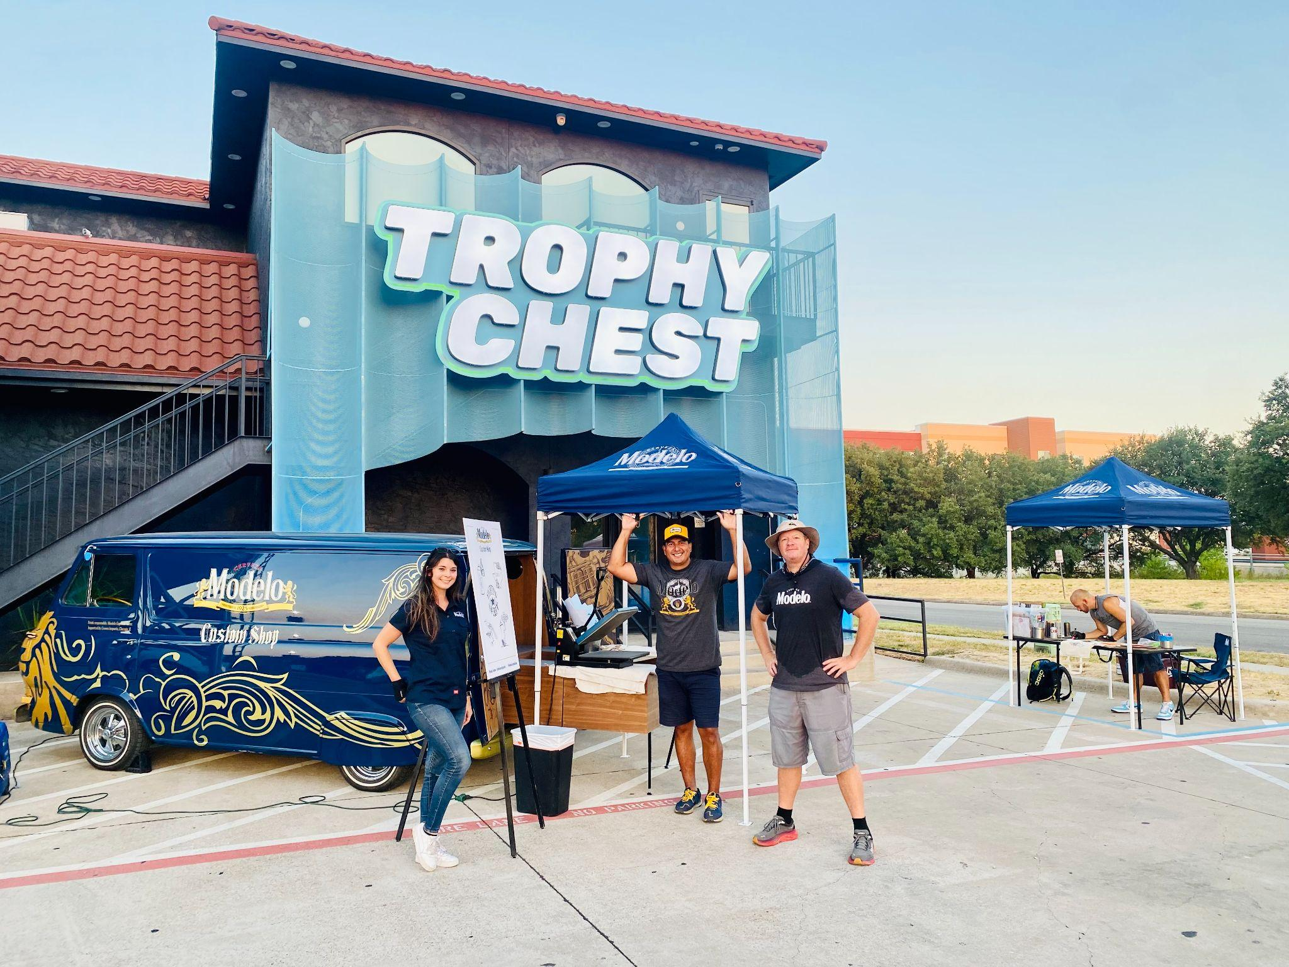
To adjust the chart style, right-click or control-click on the chart and select “Format Chart Area”

Slide 28
THANK YOU!
© MOMENTUM WORLDWIDE 2023 IN CONFIDENCE. THIS DOCUMENT MAY NOT BE DISTRIBUTED OR COPIED WITHOUT PRIOR CONSENT.

Slide 29
ACCOUNT APPENDIX
© MOMENTUM WORLDWIDE 2023 IN CONFIDENCE. THIS DOCUMENT MAY NOT BE DISTRIBUTED OR COPIED WITHOUT PRIOR CONSENT.

Slide 30
MODELO CUSTOM SHOP ACCOUNT DETAILS
ACCOUNT | ADDRESS | EVENTS | IMPRESSIONS | ENGAGEMENTS | SAMPLES | SPEND
Austin Ave. Plano | 935 W Parker Rd. | 2 | 169 | 169 | 140 | $967.77
Barra Libre | 2627 Jefferson Blvd | 2 | 209 | 170 | 120 | $927.11
Federales | 2820 Commerce St | 1 | 125 | 90 | 60 | $461.70
HG Supply | 2008 Greenville Ave | 2 | 80 | 80 | 60 | $461.70
J Gilligan’s | 400 E Abram St | 1 | 500 | 350 | 60 | $448.15
Lava Cantina | 5805 Grandscape Blvd | 1 | 90 | 90 | 70 | $493.76
Longhorn Icehouse | 1901 W Northwest Hwy | 1 | 75 | 75 | 60 | $461.70
Maggies R&R | 1264 W Magnolia Ave | 2 | 135 | 135 | 105 | $458.23
Panther City BBQ | 201 E Hattie St. | 2 | 167 | 137 | 81 | $632.04
Poag Mahones | 700 Carroll St | 2 | 220 | 185 | 120 | $511.00
Rock & Brews | 5351 Nebraska Furniture Mart Dr. | 1 | 90 | 90 | 70 | $569.01
*Some accounts had low sampling numbers due to the high heat/outdoor venues.

Slide 31
MODELO CUSTOM SHOP ACCOUNT DETAILS
ACCOUNT | ADDRESS | EVENTS | IMPRESSIONS | ENGAGEMENTS | SAMPLES | SPEND
Rusty Nickel | 2836 Stanley Ave | 2 | 160 | 160 | 90 | $662.53
Standard Service | 5631 Alta Ave | 2 | 148 | 148 | 60 | $846.44
Stix Icehouse | 301 Eldorado Pkwy #100 | 1 | 90 | 90 | 66 | $363.83
The Lononder | 5120 State HWY 121 | 1 | 80 | 80 | 60 | $545.58
Rabbit Hole Pub | 3237 White Settlement | 2 | 140 | 140 | 120 | $798.16
Touchdowns | 1409 N Cockrell Hill Rd | 1 | 20 | 20 | 24 | $218.92
Trader’s Village | 2602 Mayfield Rd | 1 | 1,400 | 300 | 160 | $846.95
Trophy Chest | 2225 Connector Dr | 1 | 85 | 85 | 60 | $384.75
Twin Peaks | 1500 Market Pl Blvd | 1 | 200 | 130 | 95 | $669.58
Woody’s | 4744 Bryant Irvin Rd | 1 | 130 | 118 | 60 | $331.24
Yard Dawgs | 217 FM 544 suite 511 | 2 | 157 | 157 | 143 | $724.20
Zona Caliente | 209 E Pleasant Run Rd | 1 | 21 | 21 | 21 | $159.56
Grand Total | 23 | 34 | 3,341 | 3,115 | 2,025 | $13,707

Slide 32
MODELO CUSTOM SHOP SALES DATA
-
TBD
To adjust the chart style, right-click or control-click on the chart and select “Format Chart Area”

